Slide 1
Scaling Market Networks in the S&P 500:
From Stocks to Sectors
Sector ETFs vs Individual Stocks
COMP0047 — Data Science Challenge Lab
Members: Jieqing Mo, Jasmine Chin, Samen Polishchuk, Qizhe Jiang, Finn Smith, Abbinav Sankar, Charlotte Connors, Aidan Meazzo, Zheng Zhu, Lorenzo Damiano
Notes:
Title slide. Introduce yourselves briefly. State the research question: How does correlation-based network structure differ when we model the market at sector ETF level versus individual S&P 500 stock level?

Slide 2
Research Objectives
Compare network scales
Build correlation-based networks at sector ETF level (9-11 nodes) and individual stock level (343 nodes)
Identify structural differences
Use Minimum Spanning Trees and degree analysis to find hub stocks and sector clustering patterns
Analyse dynamics
Track how average correlation evolves over time using rolling windows (epoch=40, shift=20 days)
Interpret financial meaning
Understand what network topology reveals about diversification and systemic risk
Notes:
Walk through each objective. Emphasise that the core question is about scale: does the market look different when you zoom from 9 sector ETFs to 343 individual stocks? Mention Kukreti et al. (2020) as the reference paper that inspired this approach.

Slide 3
Data Description
Sector ETFs
S&P 500 Constituents
Source: Yahoo Finance (Adj. Close)
Period: Jan 2000 – Mar 2026
2000 dataset: 9 ETFs, 6 562 days
2018 dataset: 11 ETFs, 1 919 days
XLF, XLK, XLE, XLV, XLU, XLB, XLI, XLP, XLY
+ XLC, XLRE from 2018
Source: Yahoo Finance (Adj. Close)
Period: Jan 2000 – Mar 2026
343 stocks across 11 GICS sectors
6 583 trading days
Naming: SECTOR_TICKER
e.g. IT_AAPL, FIN_JPM, ENE_XOM
Log returns computed as ln(Pₜ/Pₜ₋₁). NaN rows dropped per dataset.
Notes:
Explain the two data granularity levels. The 2000 sector dataset has 9 ETFs because XLC and XLRE didn't exist until 2018. The 2018 dataset includes all 11. The S&P 500 set has 343 stocks — the ones with complete price history over the full period. Mention the naming convention: each stock is prefixed with its GICS sector code.

Slide 4
Methodology
1
Log Returns
Compute daily log returns from adjusted close prices
2
Correlation Matrix
Pearson correlation ρᵢⱼ over full period (or rolling window)
3
Distance Transform
dᵢⱼ = √(2(1 − ρᵢⱼ)) maps correlation to metric distance
4
MST Construction
Minimum Spanning Tree connects all nodes with minimum total distance
5
Network Analysis
Degree distribution, hub identification, sector clustering
Ref: Kukreti et al. (2020), Frontiers in Physics
Notes:
Keep this quick — no more than 1 minute. The audience has seen correlation before. The key thing to stress is the distance transformation: it converts correlation into a proper metric so we can apply graph algorithms. Mention that the MST retains N-1 edges from N(N-1)/2 possible, extracting the backbone of the network.

Slide 5
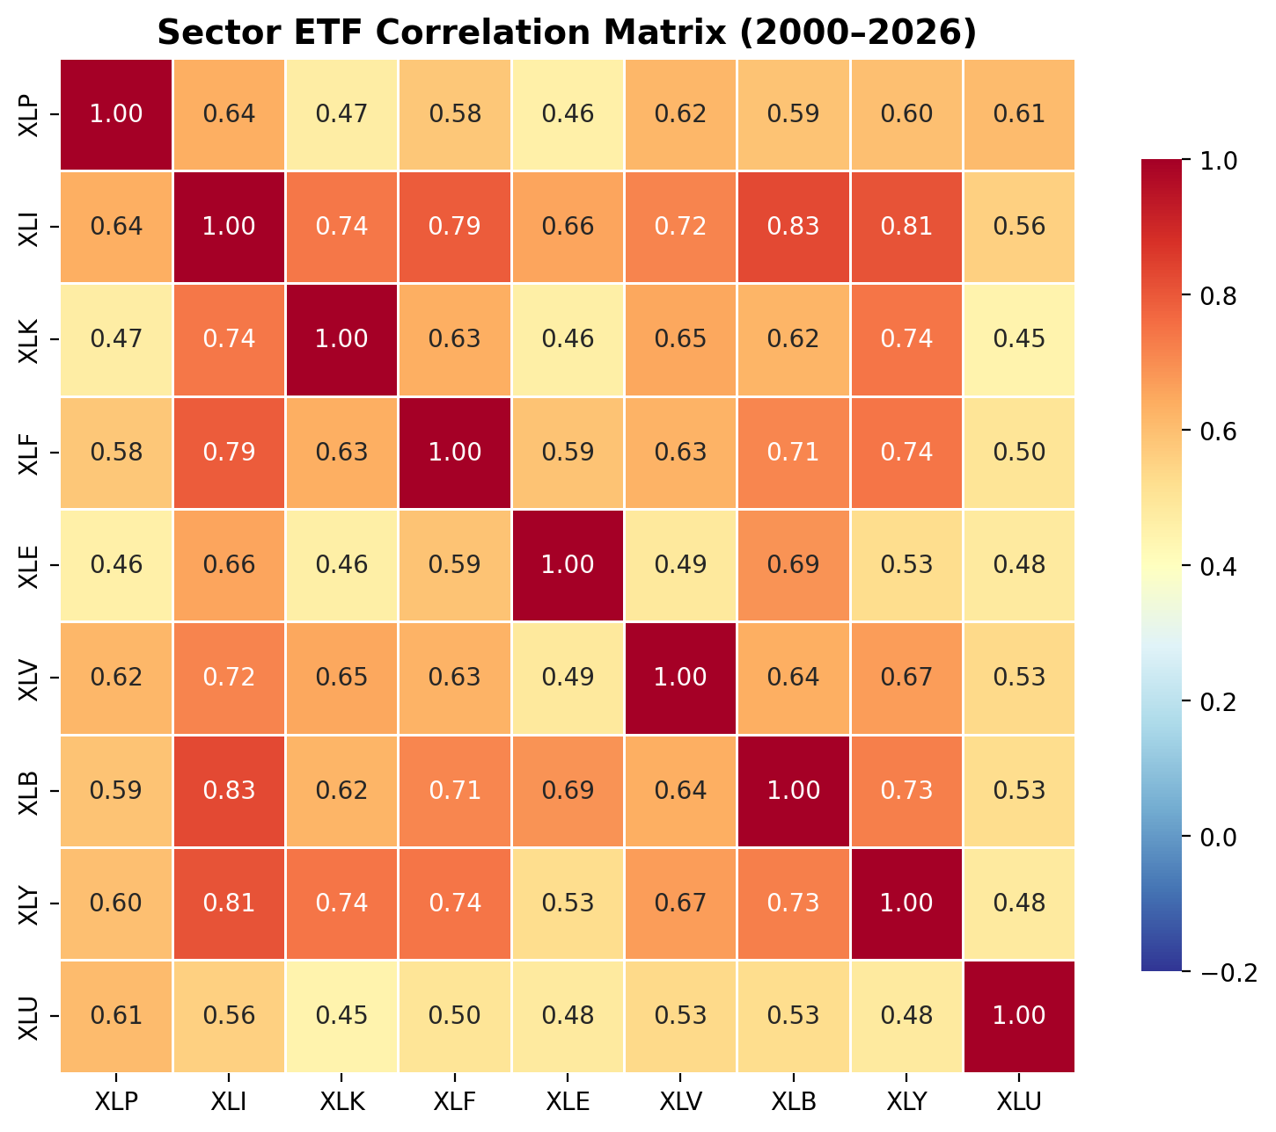
Sector Correlation Structure
Key Findings
All sector pairs positively correlated (ρ > 0.6)
Energy (XLE) is the least correlated with other sectors
Industrials & Materials show highest cross-correlation
High baseline correlation suggests limited diversification at sector level
Notes:
Explain the heatmap: full-period Pearson correlation of daily log returns among 9 sector ETFs (2000-2026). Key point: even the weakest pair (Energy vs others) shows ρ ≈ 0.6, meaning sectors move together more than they diverge. This motivates looking at the stock level where we might find more heterogeneity.

Slide 6
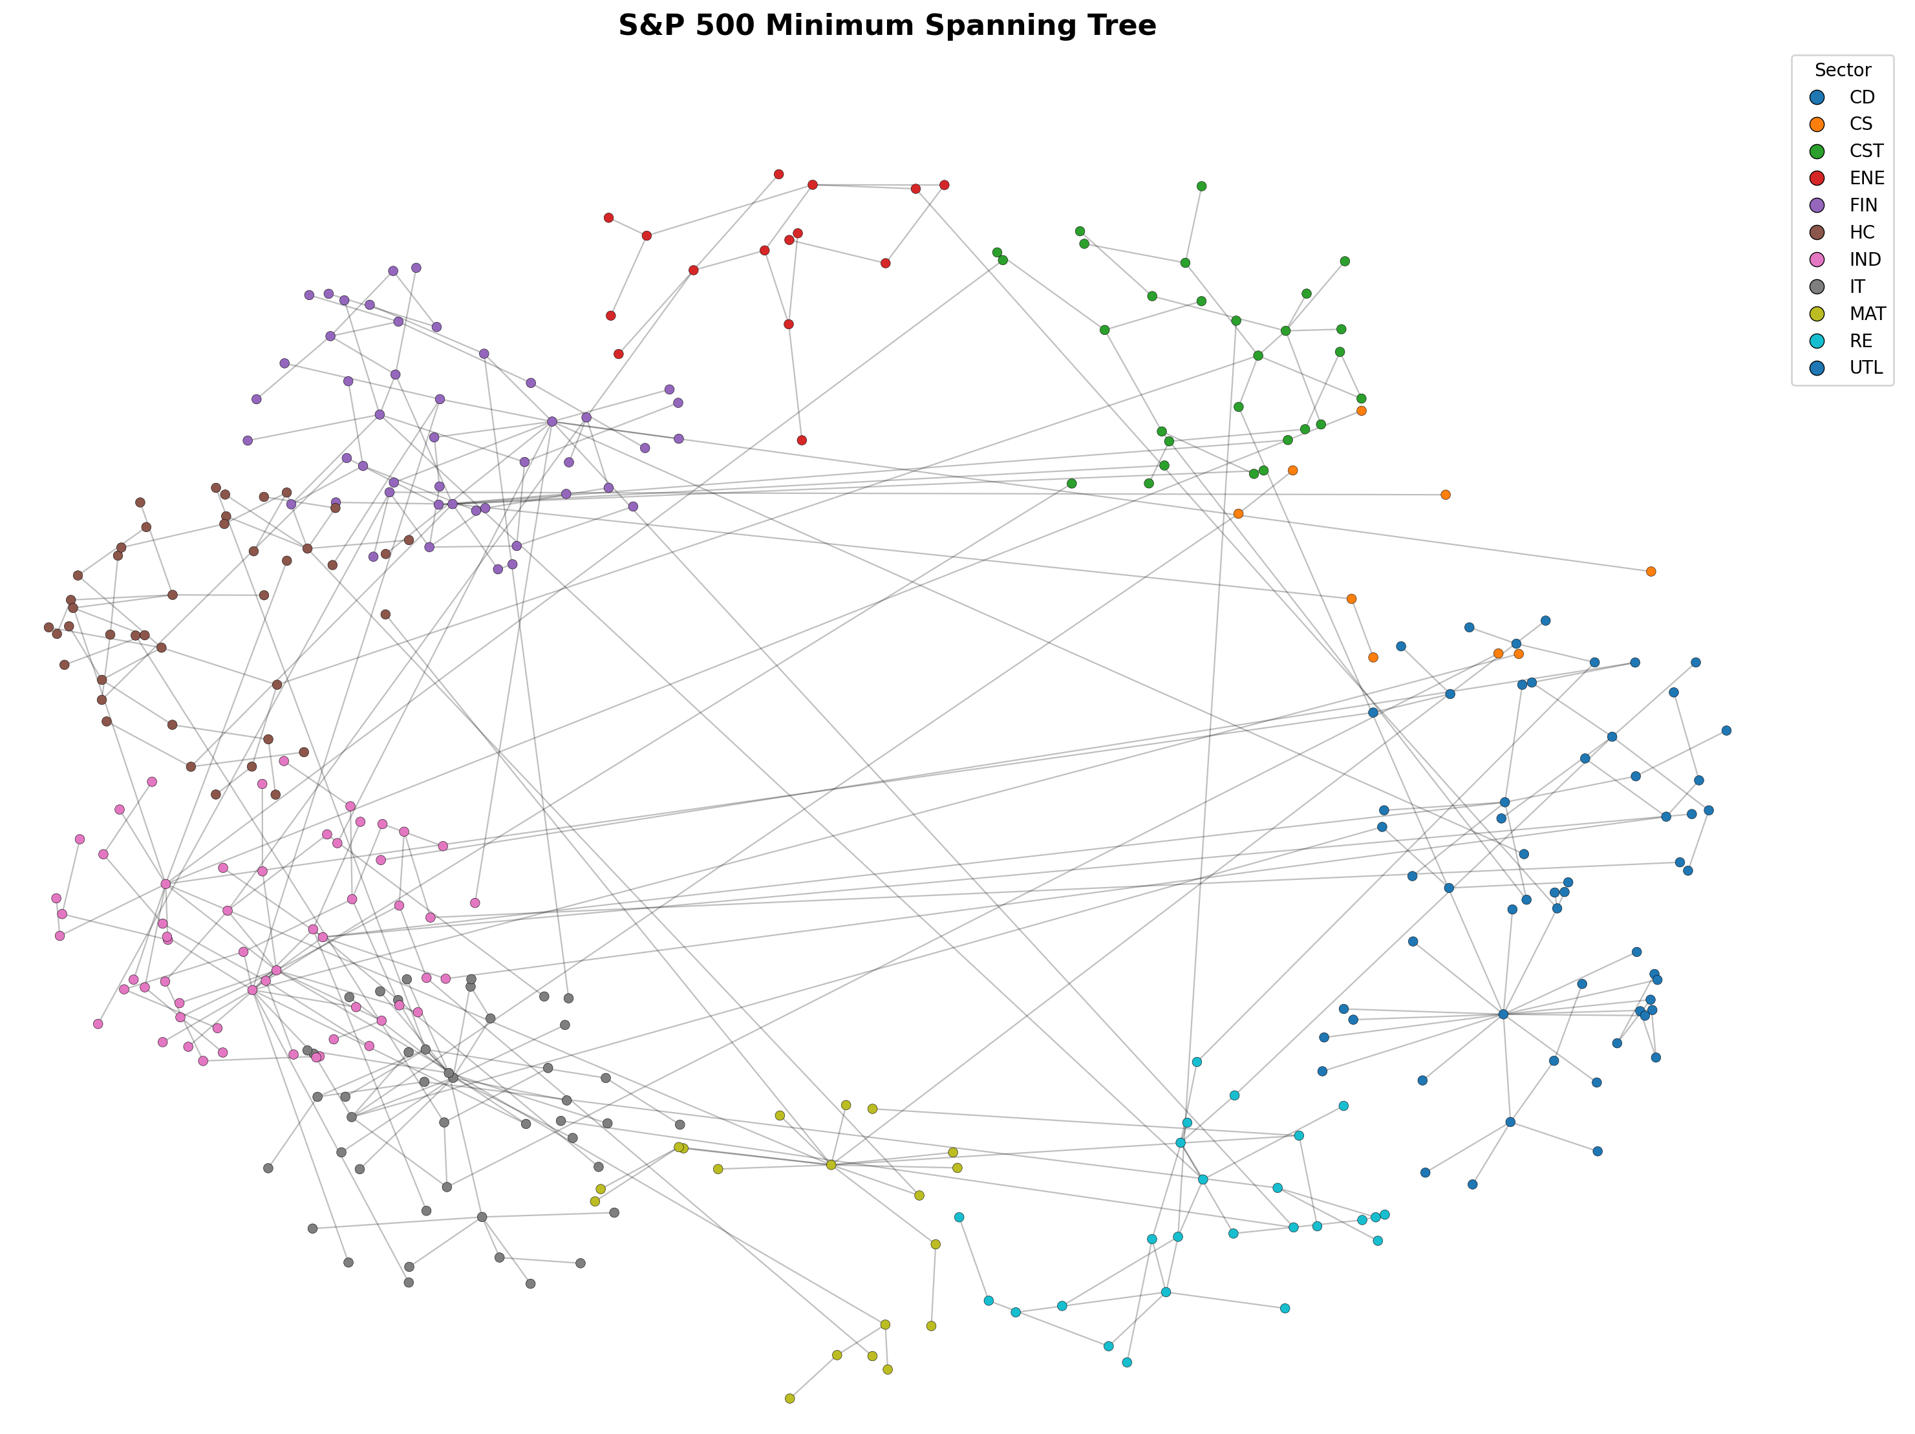
S&P 500 Minimum Spanning Tree
Notes:
This is the centrepiece figure. 343 stocks, nodes coloured by GICS sector. Point out the visible sector clustering — stocks from the same sector tend to group together in the MST, confirming that sector membership is a strong driver of co-movement. Highlight the hub-and-spoke topology: a few highly connected nodes (hubs) bridge multiple clusters. We'll identify those hubs on the next slide.

Slide 7
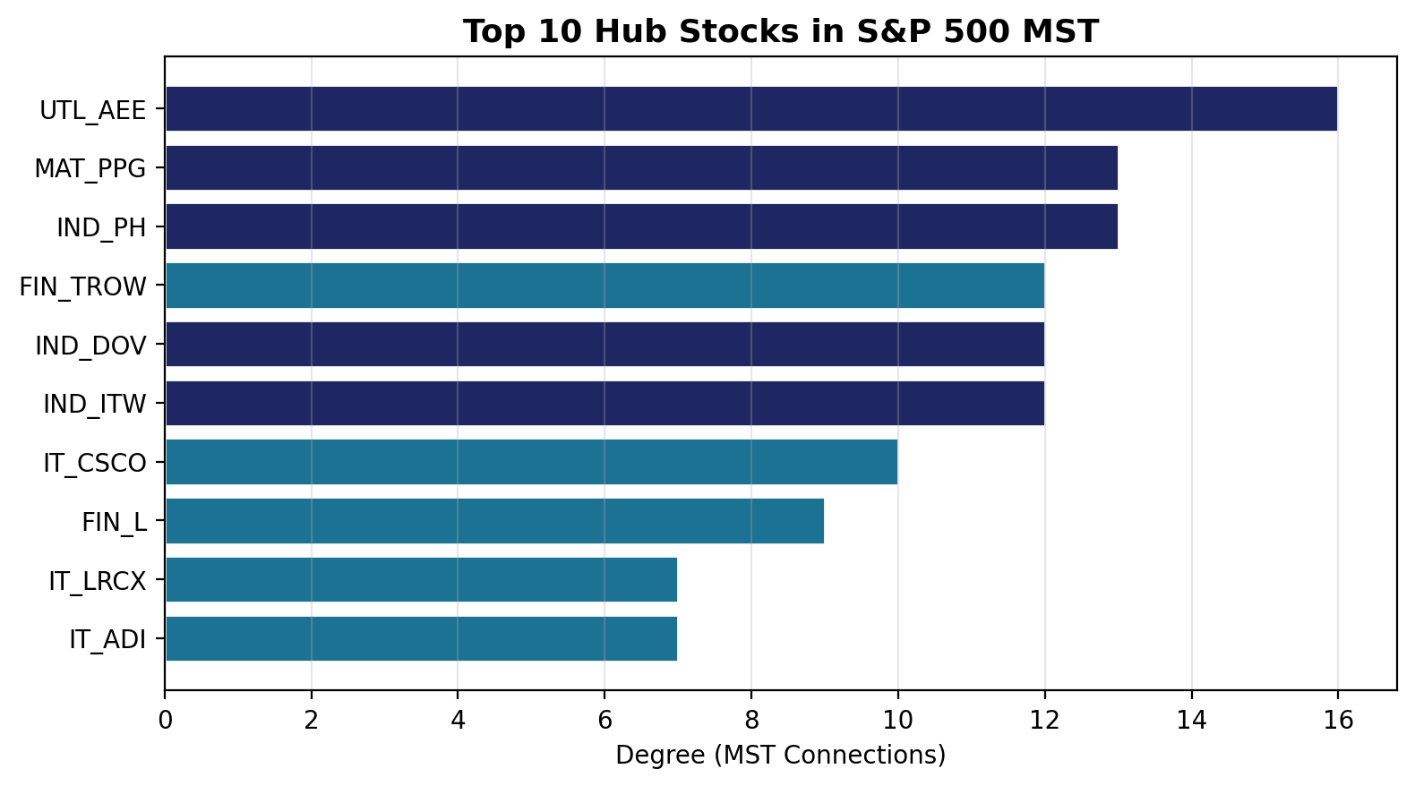
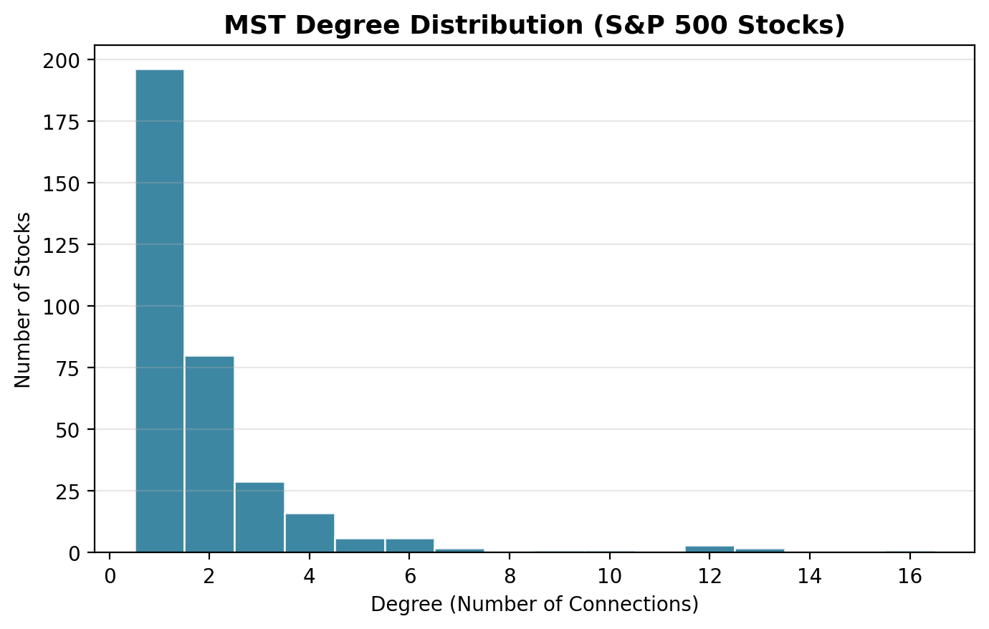
Hub Stocks & Connectivity
UTL_AEE (deg 16) and MAT_PPG / IND_PH (deg 13) are the main hubs. Heavy-tailed degree distribution → scale-free-like topology.
Notes:
Left chart: top 10 hub stocks by MST degree. UTL_AEE (Ameren, utilities) has 16 connections — surprising since utilities are traditionally defensive. MAT_PPG and IND_PH are industrials/materials which makes more sense as central connectors. Right chart: degree distribution is right-skewed (most nodes have 1-2 connections, few have 10+), consistent with a scale-free-like network. This means removing hub stocks would fragment the network — relevant for systemic risk.

Slide 8
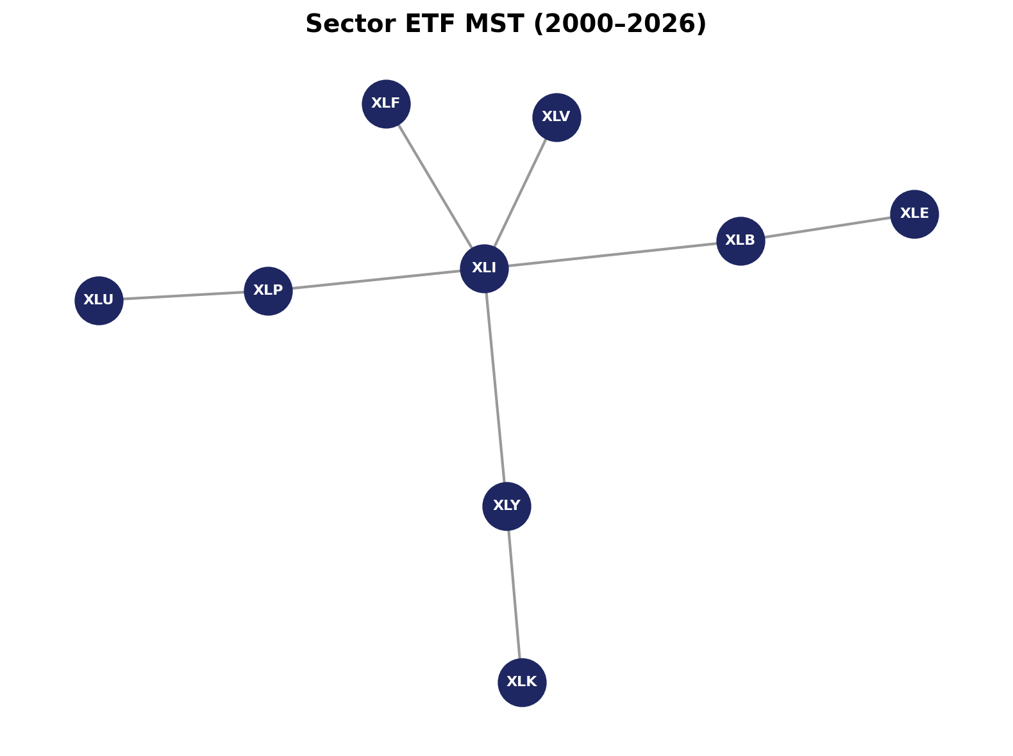
Sector ETF Network
Observations
9 nodes, 8 edges — much simpler structure
XLI (Industrials) acts as central hub
XLE (Energy) is peripheral — least connected
At sector level, individual stock heterogeneity is averaged away
Notes:
Contrast with the S&P 500 MST. With only 9 nodes the network is trivially small — every node is at most 2-3 hops from every other. XLI tends to be central because industrials correlate with many sectors. XLE is on the periphery, consistent with what we saw in the heatmap. The point: at sector level you lose all the rich internal structure that exists within each sector.

Slide 9
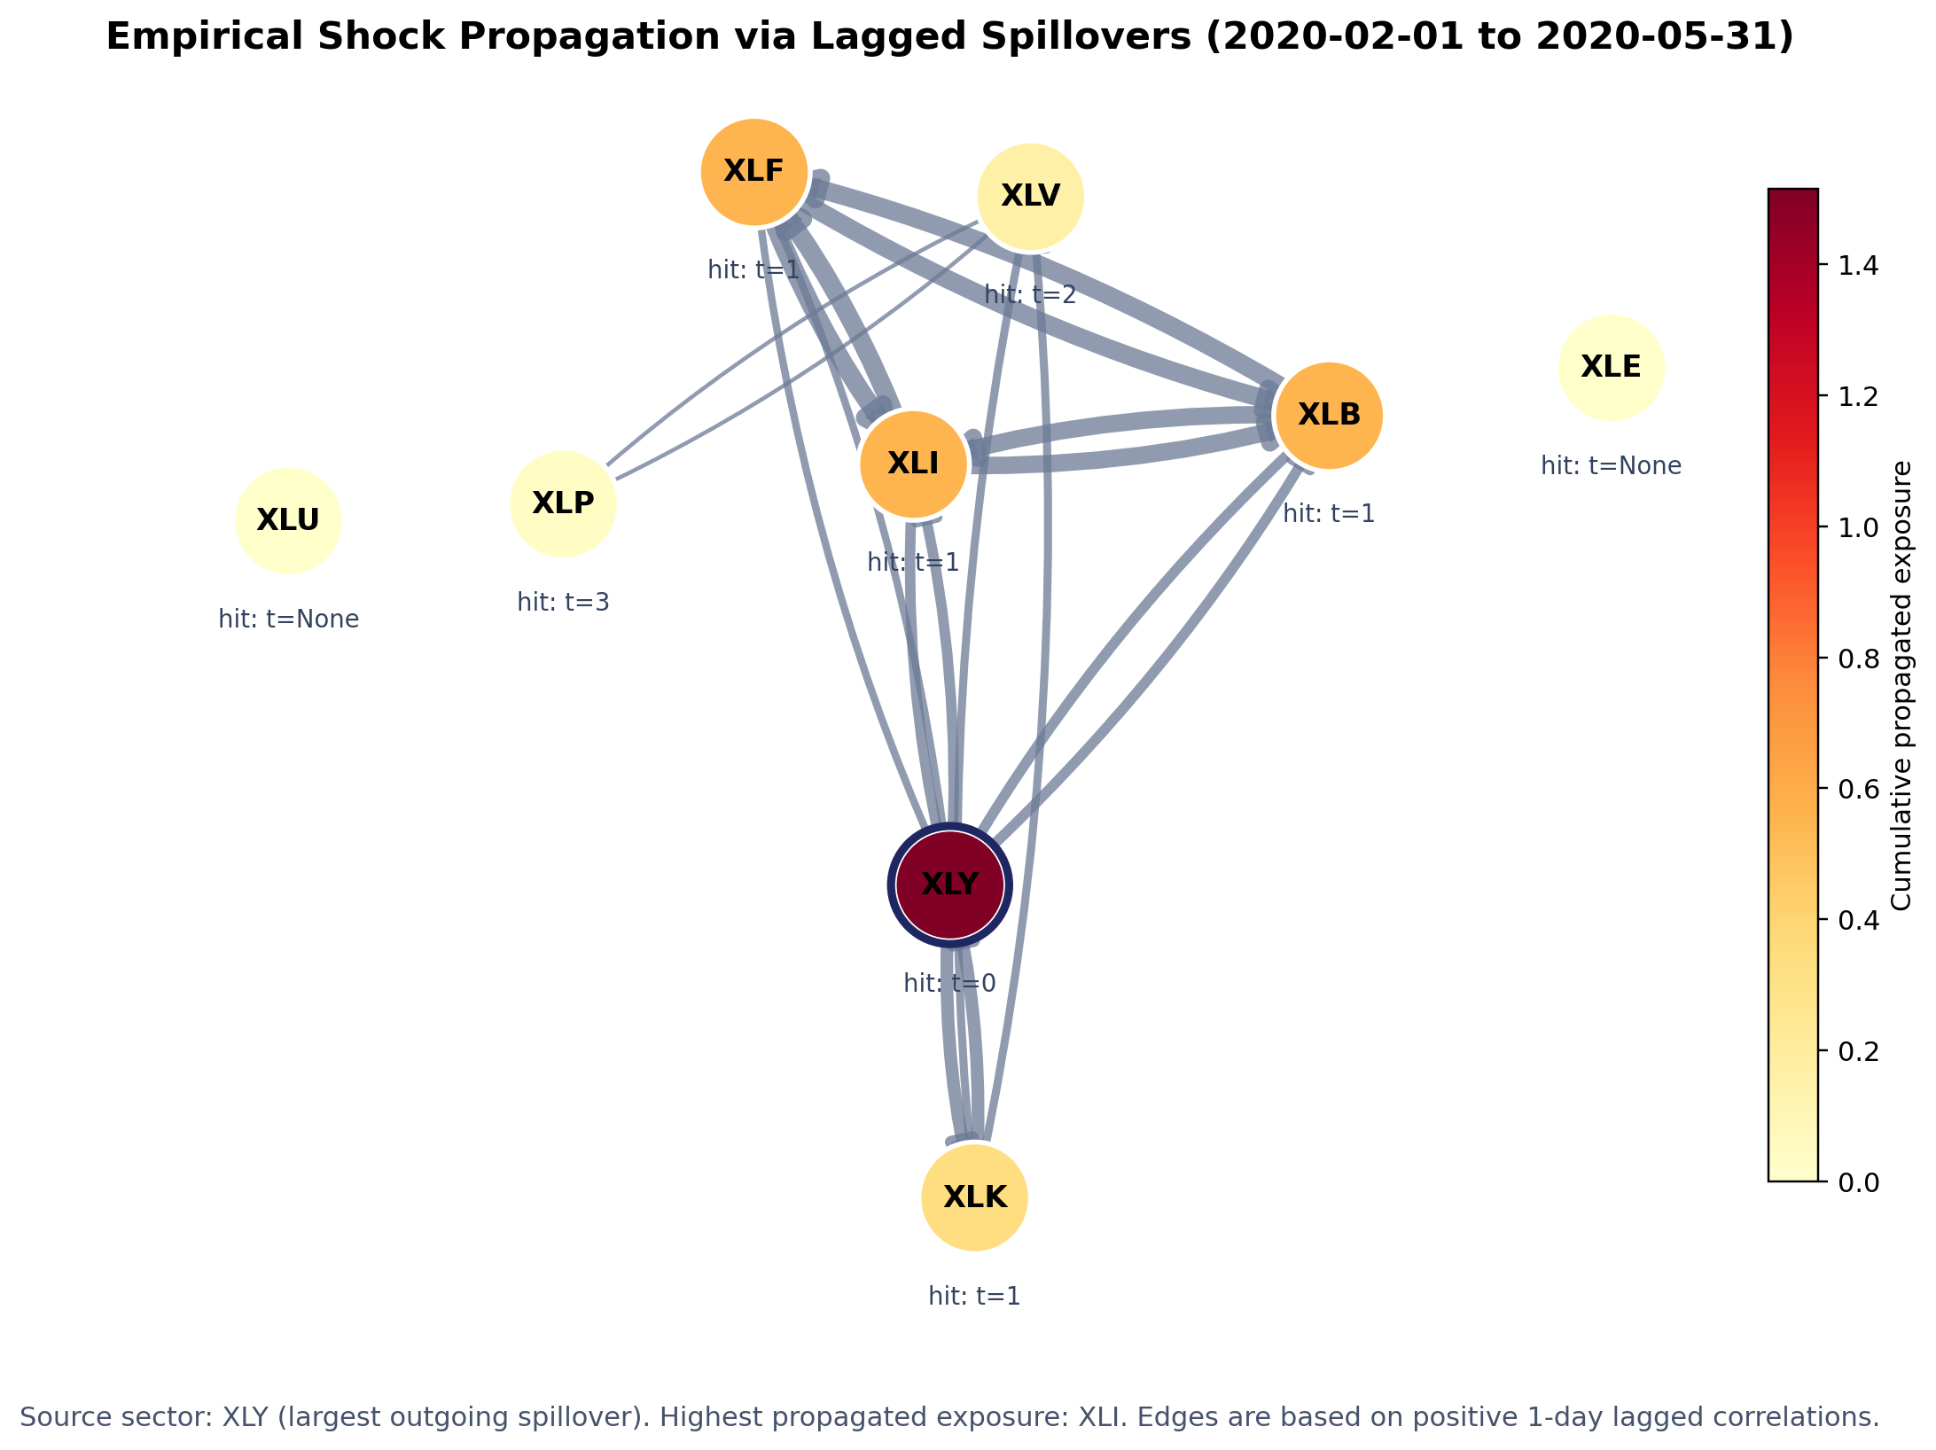
Sector Shock Propagation During COVID-19
Key idea
This is a statistical spillover map
Directed edges show 1-day lead–lag links during the Feb–May 2020 crisis
Darker nodes indicate sectors with greater propagated exposure
Notes:
[Sources] - User-provided Financial_Network_Analysis_Prezi.pptx used to match layout, colours, and topic framing. - User-provided Networks Presentation - DS.pdf used to align the propagation slide with the stated 'Propagation Model' and 'Propagation Results' direction. [/Sources]

Slide 10
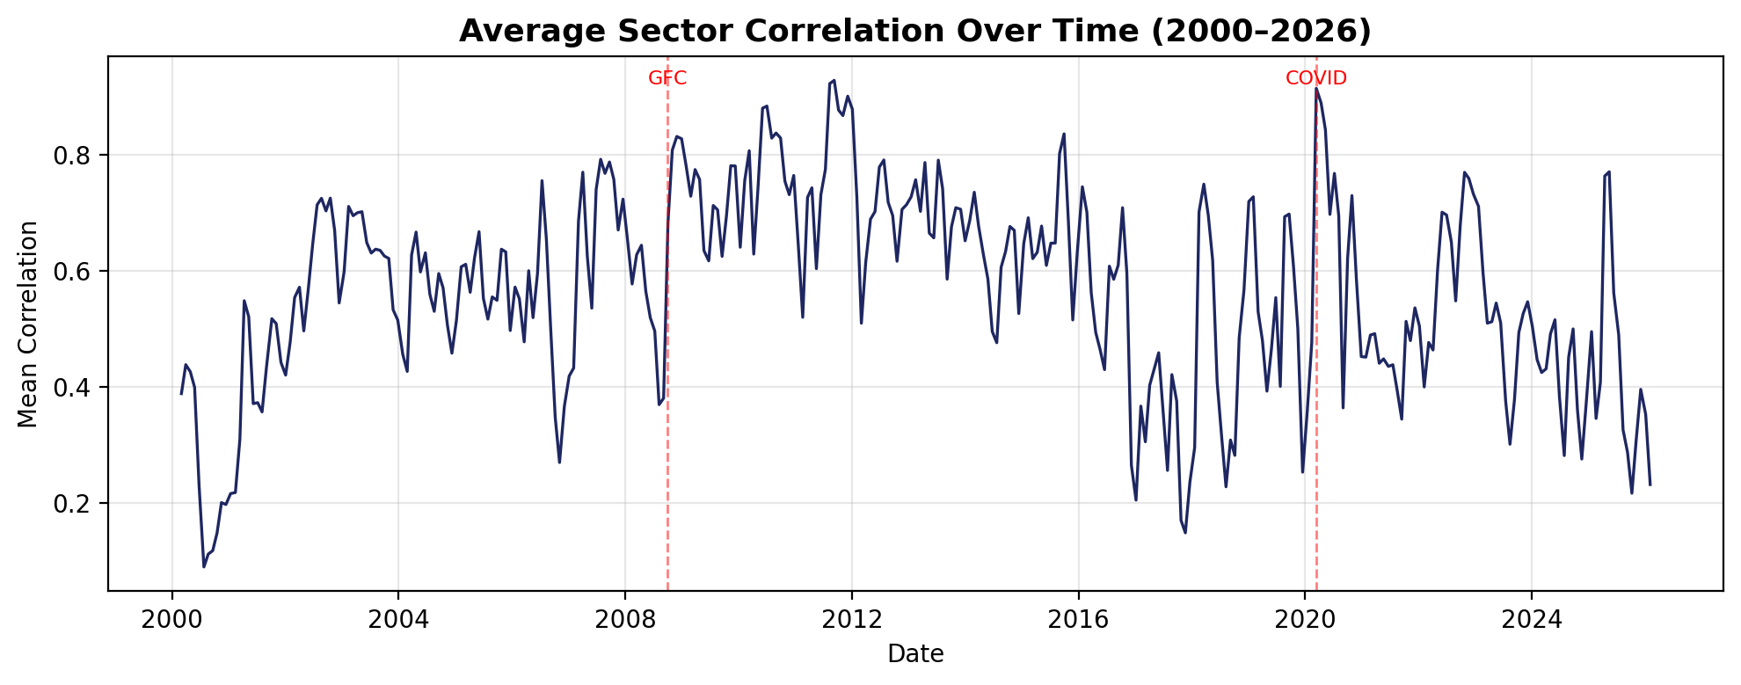
Correlation Dynamics Over Time
Rolling average off-diagonal correlation (epoch=40 days, shift=20 days). Spikes during GFC (2008), COVID (2020).
Notes:
This shows how average pairwise correlation evolves over time using a rolling 40-day window. Key events: the Global Financial Crisis (2008-09) shows a massive spike — correlations converge toward 1 as everything falls together. COVID crash (March 2020) shows a similar but sharper spike. Between crises, sector-level correlation stays higher and less volatile than stock-level, because averaging within sectors dampens idiosyncratic noise.

Slide 11
Sector vs Stock: Key Differences
Dimension | Sector ETFs | S&P 500 Stocks
Nodes | 9 – 11 | 343
MST Edges | 8 – 10 | 342
Avg Correlation | ~0.75 – 0.85 | ~0.25 – 0.45
Hub Structure | XLI central | UTL_AEE, MAT_PPG, IND_PH
Clustering | Not meaningful (too few nodes) | Clear sector clustering visible
Crisis Response | High, uniform spike | Variable by stock/sector
Notes:
This is the summary comparison slide. Walk through each row briefly. Key takeaway: sector-level analysis is useful for a quick macro view, but it masks significant within-sector heterogeneity. At the stock level, you discover that the real hubs are specific companies (not just 'the industrials sector') and that sector clustering is an emergent property of individual stock correlations, not imposed by sector labels.

Slide 12
Conclusions & Future Work
Stock-level networks reveal rich structure (hubs, sector clusters) invisible at sector level
MST topology is scale-free-like: a few hub stocks connect the entire market
Correlations spike uniformly during crises, reducing diversification benefits
Sector ETFs average out within-sector heterogeneity, losing actionable detail
Key Conclusions
Future Directions
Threshold networks and PMFG for denser graph comparisons
Regime detection via correlation breakpoints
Calibrated contagion models beyond simple lead–lag spillovers
Notes:
Summarise the three main takeaways: (1) scale matters — stock-level reveals what sector-level hides; (2) hub stocks are critical structural nodes; (3) crises collapse the network into near-complete correlation. For future work, mention threshold networks and PMFG as richer graph methods, regime detection to identify structural breaks automatically, and propagation/contagion models to test what happens when a hub stock fails. Thank the audience and open for questions.

